Slide 1


Slide 2
Introduction
Submitted By
Submitted To
1. Grace Joydhar - 151-15-5075
2. Md. Mirazul Islam Shohag - 151-15-5134
3. Reshma khatun - 151-15-4785
4. Md. Arif Ahmed - 151-15-5110
5. Renu Akther - 151-15-5096
6. Tanha Tasnim – 151-15-5420
Md. Aynul Hasan Nahid
Lecturer
Dept. of CSE
Daffodil International University

Slide 3
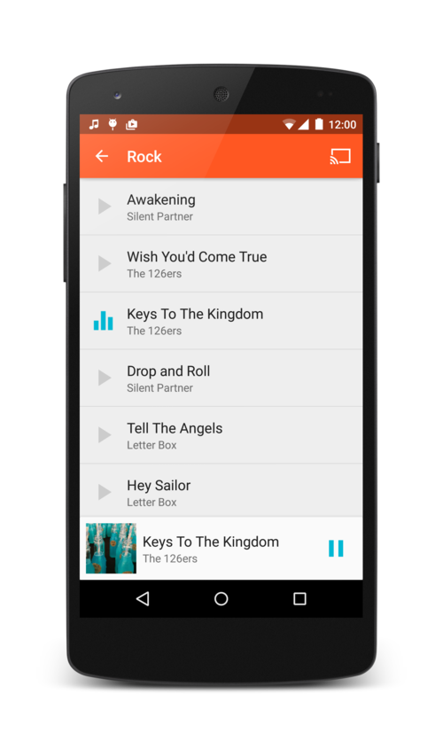
Media Player

Slide 4
Index
1. Motivation
2. Features
3. Screenshots
4. Tools
5. Conculsion

Slide 5

Motivation
Every day we can find different types of music player by
searching on internet. so we thought that we can make
a music player with different activity and also want to try to
Make an apps which needs limited memory space.
also.

Slide 6
Features
Audio song player
Background playing
Play / pause function
Progress bar
Smaller size
Organize all audio songs

Slide 7
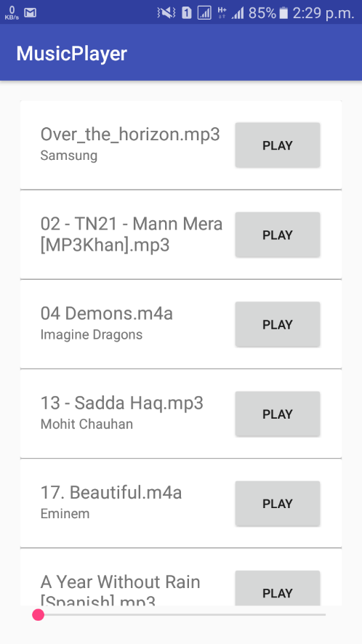
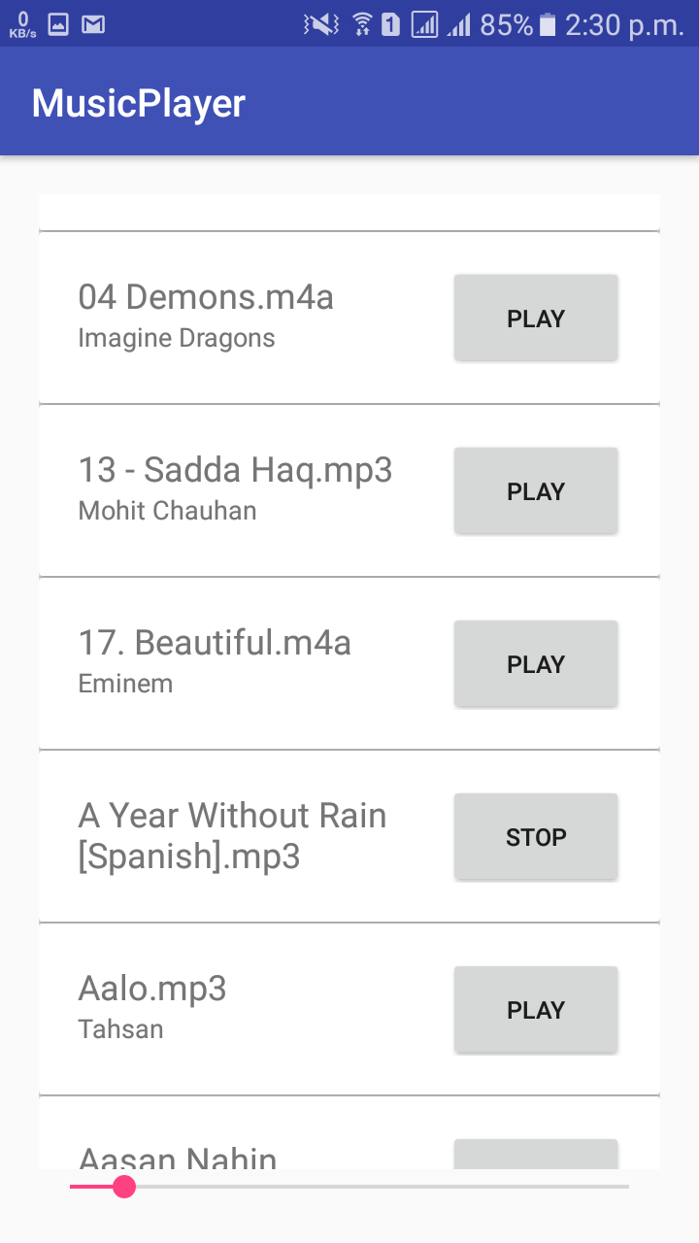
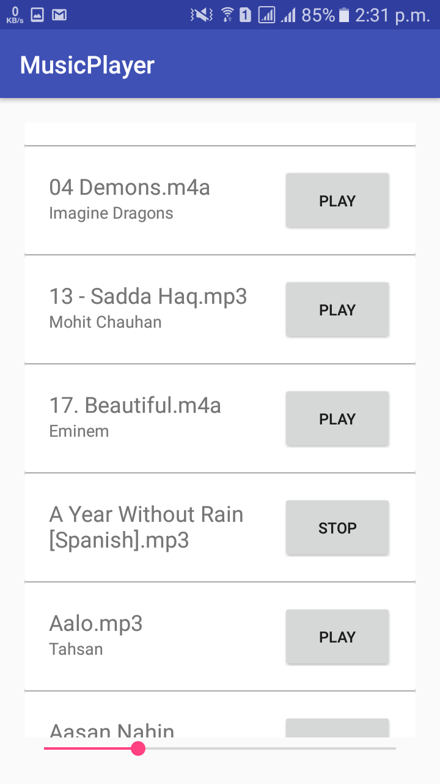
Screenshots

Slide 8
Tools
Platform
Android Studio 3.0
Java, XML
Android library use
android.media.MediaPlayer
android.provider.MediaStore

Slide 9
Conclusion
Limitations
Can’t play video
Can’t play from online
Can’t create playlist
Don’t have next / previous button
Don’t have any equalizer

Slide 10
Conclusion
Future Work
Add video player
Playlist creation
Online streaming
More user friendly

Slide 11


